Slide 1
Data Structure Lab 02 Review on C++ concepts and OOP part II

Slide 2
Agenda
Function template
Generic class
Inheritance
Function overriding
Why OOP

Slide 3
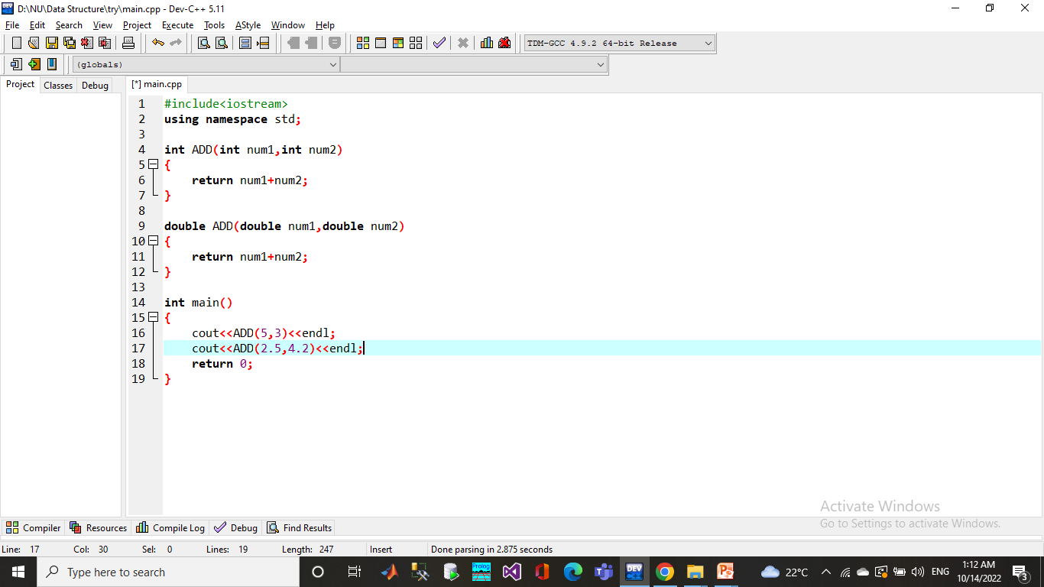
Function Overloading
Functions with same name and different parameters
Overloaded functions should perform similar tasks

Slide 4
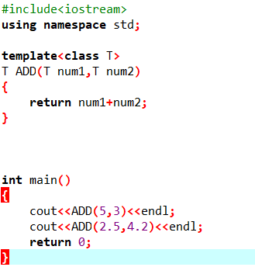
Function template
The simple idea is to pass data type as a parameter so that we don’t need to write the same code for different data types.

Slide 5
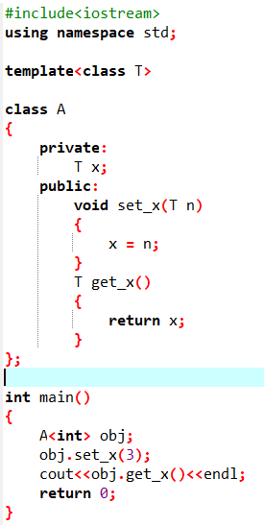
Generic class
Like function templates, class templates are useful when a class defines something that is independent of data type.

Slide 6
Inheritance
The capability of a class to derive properties and characteristics from another class is called Inheritance.
The old class is known as “base” class, “super” class or “parent” class”; and the new class is known as “sub” class, “derived” class, or “child” class.

Slide 7
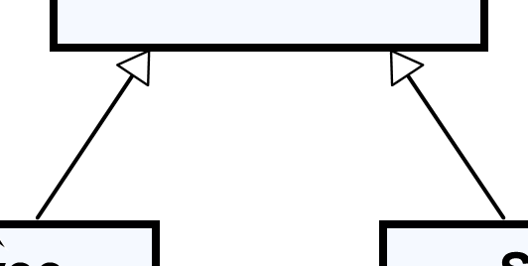
Inheritance - UML Representation
This is a Generalization relationship
“IS-A”
Superclass
(Base Class)
Person
+Name: String
+Address: String
Subclass
(Derived Class)
Subclass
(Derived Class)
Employee
Student
+Company: String
+Salary: double
+School: String
Notes:
Generalization expresses a parent/child relationship among all classes

Slide 8

Inherit a Base Class, reusing parent constructor

Slide 9
class Person
{
private:
int id;
string name;
public:
Person(int id, string name){
this->id = id;
this->name = name;
}
~Person(){
cout<<"object with id "<<this->id<<" has been destroyed.";
}
void display(){
cout<<"I'm a person with id "<<this->id<<" named: "<<this->name<<endl;
}
};
class Employee: public Person{
public:
Employee(int id, string name): Person(id, name){
}
};
int main(){
Person some_person(123, "Ahmed");
some_person.display();
Employee some_employee(456, "Monier");
some_employee.display();
return 0;
}
Output:
I'm a person with id 123 named: Ahmed
I'm a person with id 456 named: Monier
object with id 456 has been destroyed.
object with id 123 has been destroyed.

Slide 10
Inheritance
Access specifier meaning:
● Base class's private members can not be accessed in a derived class.
● Base class's protected members can be accessed in a derived class.
● Base class's public members can be accessed from anywhere
Notes:
Protected access modifier is similar to that of private access modifiers, the difference is that the class member declared as Protected are inaccessible outside the class but they can be accessed by any subclass(derived class) of that class.

Slide 11
Key Concepts:
Private members:
Can only be accessed within the class in which they are declared.
Not accessible in derived classes or from outside the class.
Protected members:
Can be accessed within the class they are declared in and by derived classes.
Cannot be accessed from outside the class.
Public members:
Can be accessed from anywhere: inside the class, in derived classes, and even from outside the class using an object.

Slide 12
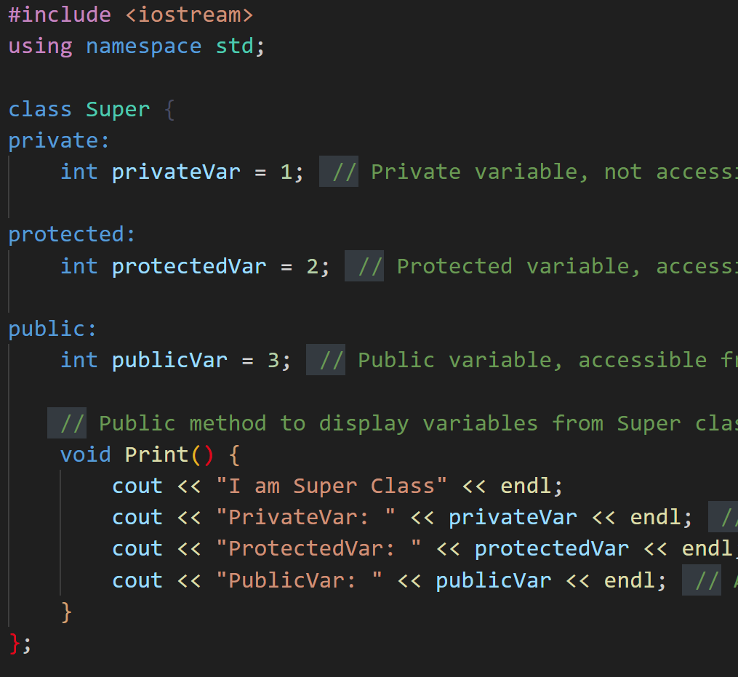
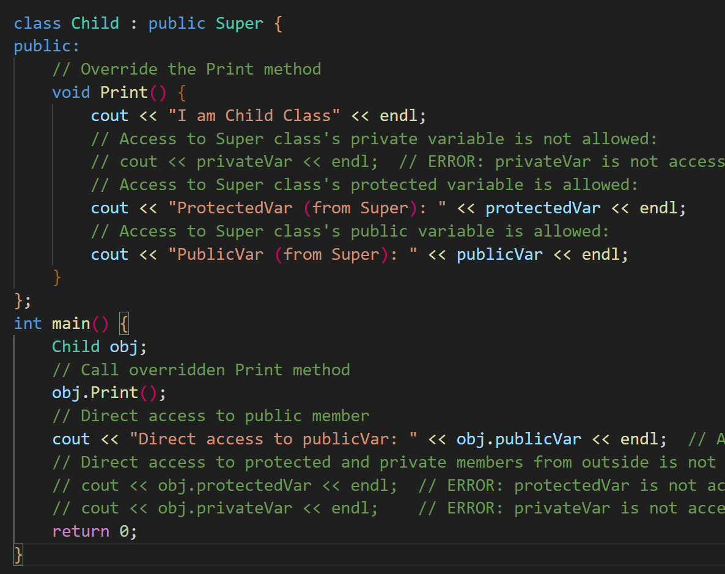
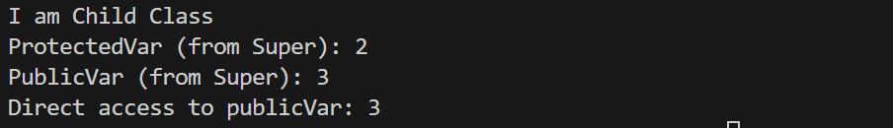

Slide 13
Check Access Specifiers .cpp

Slide 14
Function Overriding vs Function Overloading
Function Overloading: Same function name but with different parameter lists in the same class or scope, resolved at compile time.
Function Overriding: Redefining a function in a derived class with the same signature as the base class, resolved at runtime using inheritance

Slide 15
Function Overloading
Functions with same name and different parameters
Overloaded functions should perform similar tasks

Slide 16
Check Function Overloading .cpp

Slide 17
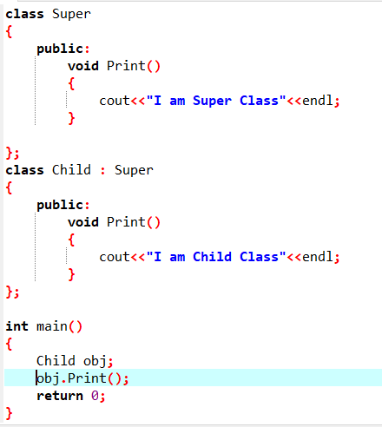
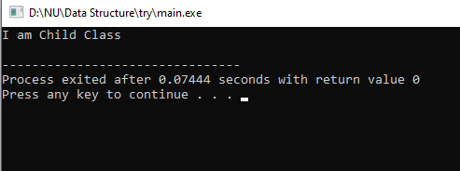
Function Overriding
It is the redefinition of base class function in its derived class with same signature (i.e., return type and parameters).
It can only be done in derived class.

Slide 18
Check Function Overriding.cpp

Slide 19
Function Overriding vs Function Overloading
Aspect | Function Overloading | Function Overriding
Definition | Multiple functions with the same name but different parameters. | Redefines a base class function in the derived class.
Where It Occurs | In the same class or scope. | Between base class and derived class.
Function Signature | Different parameter types or numbers. | Must be identical to the base class function.
Return Type | Can differ. | Must match the base class.
Inheritance | Not required. | Requires inheritance.
Purpose | To provide multiple ways to use a function with different parameters. | To customize or extend the base class functionality.
Example | void print(int x); void print(double x); | Base: void print(); Derived: void print();

Slide 20
Why OOP?
Simplify programming
Interfaces
Information hiding:
Implementation details hidden within classes themselves
Software reusability
Class objects included as members of other classes
Inheritance

Slide 21
Summary of OOP
Object-Oriented Programming (OOP) Concepts
Encapsulation
Polymorphism
Inheritance
Information
hiding
Function
overriding
Different ways to inherit classes from other classes
Classes and objects
Constructor
and destructor
Function
overloading
Function
overriding
Access specifier
Getter and setter

Slide 22
Let us practice
Create class called Person that has:
ID number and name
Create a parameterized constructor to initialize the attributes’ values
Add a template method in the Person class to print any value.
Create class called Emp class that inherits Person class, and has:
A salary of type float
A parameterized constructor to initialize the 3 attributes
Reuse the parent’s constructor.
Create method display to print the employee’s information.
In main:
Create an object from Emp
Display his information

Slide 23
Task 1
Note that:
The classes Dog and Cat inherit the Animal class
Your program should have 3 classes.
An Animal class that has:
A protected string color with default value = “default color”.
Public Template Method:A template method print_value() that prints any value.
A display_color () method that displays the color.
A Dog class that has method update_dog_color() that updates the color value to “Brown”.
A Cat class that has method update_cat_color() that updates the color value to “White”.
In main:
Create an object from Cat and Dog.
Update their colors and display them.

